Slide 1
Crossing the Firewall
integrating Cloud Computing into the enterprise
Ken Yagen
Senior Director, MuleSource
ken.yagen@mulesource.com
www.twitter.com/kenyagen

Slide 2
Situation

Slide 3
Evolution of Architecture
Cloud Computing
Notes:
2 stages of evolution
1st developer agility
…
2nd business agility
…
Architectural equivalent of discovering fire
SOA, virtualization, SAAS, eventually cloud computing –the platform for all of these things

Slide 4




Legacy
Call
Center
CRM
Finance
HRMS
Mess-aging / Collab-oration
Notes:
Point to Point Integration
Home grown messaging abstraction
RPC only
Hand coded 3rd party integration
Hand coded security, monitoring and management

Slide 5

SOA / SAAS
IVR
Call
Center
CRM
Billing
Finance
HRMS
Mess-aging / Collab-oration
Call
Routing
Fulfill-ment
Schedul-ing
AR/AP
Enterprise Service Bus
Notes:
Picture of Legacy System Architecture

Slide 6

Cloud Computing
Notes:
Picture of Clouds. Discuss what it is and implications Hosting, B2B..SAAS..Virtualization..SOA..IT Oursourcing..P2P…Web 2.0
Realization that finally, the network is the computer
Means to deliver service (talk about later infr, platform, app)
What’s New about Cloud – self service management, elastic scaling
Role of SOA - shapes how you deliver and leverage services in the cloud

Slide 7
Reusable cloud-based services
Application as a Service
Platform as a Service
Infrastructure as a Service
Notes:
Examples of new types of reusable services
Infrastructure (IAAS) – AWS, GoGrid, Mosso, Euclyptus, 3Tera, Nirvanix
Platform Stack (PAAS) – Force.com, Google AppEngine, MS Azure
Application
Business Services (SAAS) – Billing, CRM, Payment, Advertising
Utility Services - Communication, Data Processing, Doc Mgmt, Security
Information Services – Real Time Data, Historical Data, Search

Slide 8
Complication

Slide 9
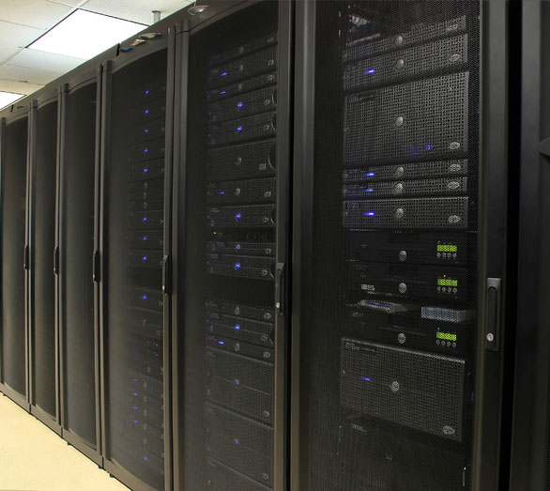
Existing investments?
Notes:
Challenge - What to do about existing investments in your Enterprise Architecture?
If you already have a SOA and are using virtualization in the data center, then you are probably in good shape
If not, you’ll need to take baby steps while you address your architecture – start with specific projects – possibly new ones that can benefit from the cloud
Investments in datacenter – public and private clouds – redeploy your existing assets into a private cloud. Already using virtualization, this will be easier

Slide 10

CONTROL
Notes:
You are handing over the keys to someone else. Loss of control / choice
SLAs can be very different, also viability
With AWS - 1 of 60,000 customers
AWS offers 99.95% SLA and offers service credits in return
Definition of outage is very convoluted. You are especially exposed if customer < 1 year
Customer must prove the outage within 30 days without help from AWS
Credit is to future service, not reimbursement of lost service
S3 went down for several hours, no data was loss but many websites were shut down until it recovered
Alternatively, 3Tera automatically monitors outages and credits you back for them
SLAs are nice, but don’t help recover business loss do to an outage.
Storage
No protection necessarily for example if FBI were to raid another company’s data that resided on the same disk as yours that yours would not be taken
Patriot Act protection
What if provider went under, could you get your data bacK?

Slide 11
Cloud-ilities?
Security
Manageability
Reliability
Scalability
Weaknesses
Strengths
Elasticity
Time to market
Notes:
secure multi-tenancy for storage not quite there yet, encryption is not standard
Manageability – tools are still very immature and no real standard across service providers
Reliability /Availability – need to vet service provider – SLA, viability, location of datacenters, reliance on any other service provider
Governance – can be much more difficult to ensure compliance
Compatibility – few standards except at protocol level (what Mule leverages). Data formats very proprietary (Mule can help some)
Self Service, quick to market, elastic scale up and down, pay per use

Slide 12
Implications

Slide 13
New Applications
IVR
Billing
CRM
Call
Routing
Fulfill-ment
Schedul-ing
AR/AP
Enterprise Service Bus
Notes:
Picture of Legacy System Architecture

Slide 14
New Applications
IVR
Billing
CRM
Call
Routing
Fulfill-ment
Schedul-ing
AR/AP
App
Enterprise Service Bus
Notes:
Picture of Legacy System Architecture

Slide 15
Virtualized Services
CRM
IVR
Billing
Call
Rtg
CRM
Scheduling
Billing
Call
Routing
Fulfill-ment
Email
Hiring
Schedul-ing
AR/AP
App
App
App
App
Enterprise Service Bus
Enterprise Service Bus
Notes:
Picture of Legacy System Architecture

Slide 16
Position

Slide 17

How do I get here?

Slide 18

Checklist
Notes:
EXPAND THIS
Can you EA adapt to it? If not private, small project
Do services represent business granularity
What are your security / compliance requirements?
New or Legacy App
Integration Points / Coupling
Protocols, Apps, Data independent
Scalability requirements – elastic or potentially fast growth
Core vs Context
ESB selection checklist –
more than one type of communication protocol? not going to get any of the benefits if cross protocol messaging and transformation that Mule provides.
publish services for consumption by other applications? This is a good fit for Mule as it provides a robust and scalable service container
more than 10 applications to integrate? Avoid big-bang projects and consider breaking the project down in to smaller parts. Pilot your architecture on just 3 or 4 systems first and iron out any wrinkles before impacting other systems.
need the scalability of an ESB? It’s very easy to over-architect scalability requirements of an application. Mule scales down as well as up making it a popular choice for ‘building in’ scalability. However, there is a price to be paid for this since you are adding a new technology to the architecture.
what do you want to achieve with your architecture? Vendors often draw an ESB as a box in the middle with lots of applications hanging off it. In reality, it does not work like that. There is a lot details that need to be understood first around the integration points, protocols, data formats, IT infrastructure, security etc. Starting small helps to keep the scope of the problem manageable. Until you understand your architecture and scope it properly you can’t really make a decision as to whether an ESB is right for you.

Slide 19
Action

Slide 20
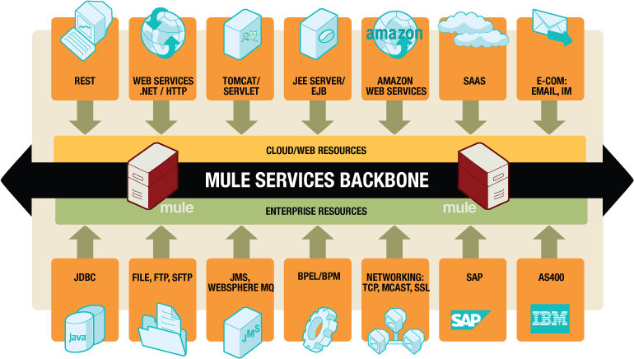

Notes:
ESB – abstraction layer on top of event driven messaging backbone. Allows you to exploit sophisticated integration patterns (including async messaging, routing, and transformation) without writing code. It is designed to be distributed and allows the parts of the system to exist in many different locations.
Mule supports both legacy and web 2.0 protocols, multiple programming models
Expose and consume any type of service
Web Protocols: SOAP, HTTP/REST, RSS, ATOM, etc
Data formats: XML, EDI, JSON, Binary, Text
Service can POJOs, Spring, EJBs, Groovy, Python, Ruby, .NET, etc.
Service Registry (Galaxy)‏
Mule manages complexity
Validate, transform, enhance data
Security, error handling, reliability and availability
Bridge internal and external services
Improves operational response time to issues
Abstract Popular Cloud Services
Create a custom transport (eg SF Transport, Flickr Transport)
Configure endpoints rather than code to APIs
Mule's lightweight approach
Simple deployment model
Standalone or embed in Tomcat
Open Source

Slide 21
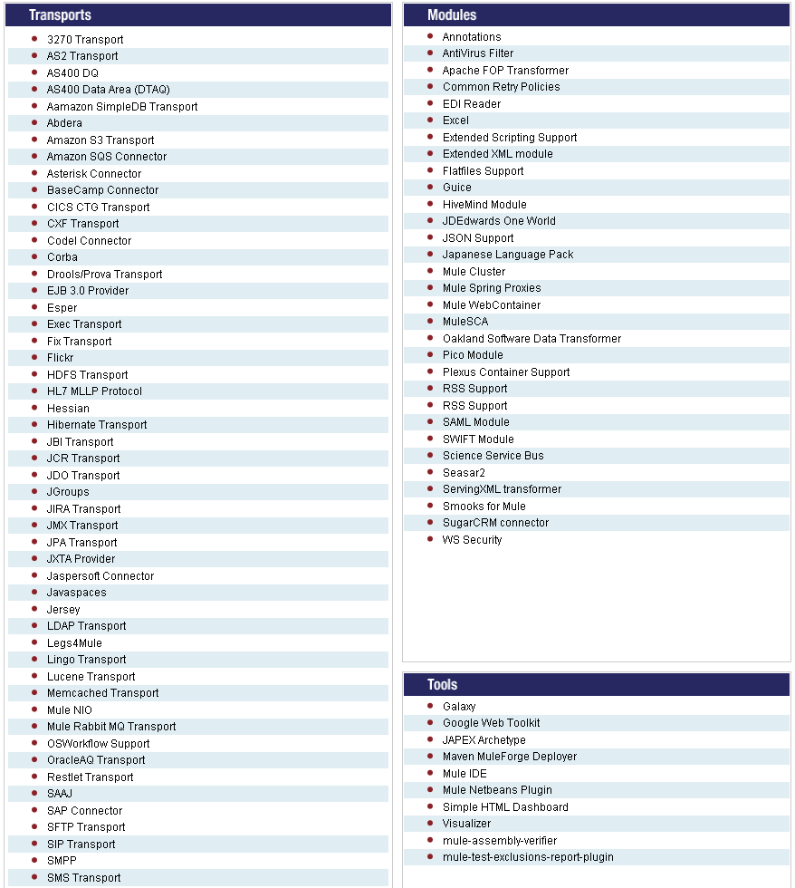

Slide 22

Which Cloud?
Private Cloud
Public Cloud
Notes:
App/SAAS
Vet service providers match needs of new application
Mule has connectors for some SAAS. New ones are very easy to create
Prototype
Deploy
Scale

Slide 23
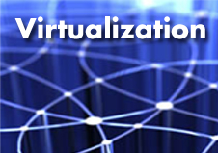
connect the dots with Mule
Notes:
Use virtualization to scale out existing apps into the cloud - IAAS
Control, Core - Consider Private
Context - Public
Mule can provide location transparency
Web protocols allow to continue to talk to internal systems
Mule can Proxy even if apps don’t speak web services
Secure communication
Building new apps
Choose IIAS or potentially PAAS
Mule can integrate with GAE, Force.com and others via REST or SOAP web services
Run Mule inside enterprise and in cloud or embedded in app
Simple, L/W allows easily cloud provisioning tools and services

Slide 24

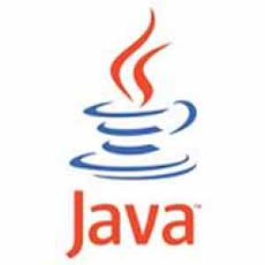
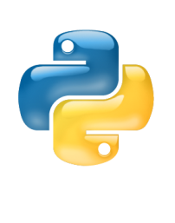




Reuse existing skills
<service name="crmServiceProxy">
<inbound>
<jms:inbound-endpoint queue="leads.queue"/>
<forwarding-router/>
</inbound>
<outbound>
<chaining-router>
<http:outbound-endpoint address=“http://www.mycrm.net”/>
</chaining-router>
</outbound>
</service>
> mvn mule-project-archetype:create \
-DartifactId=inventory \
-DmuleVersion=2.1.2

Slide 25
Conclusions
Decompose your enterprise, not just the application
Cloud computing needs SOA
Mule can bridge the gap
Follow a checklist
Leverage existing skills
Notes:
Applications are no longer silos with expensive PTP integration
Cloud computing can only be done effectively in concert with SOA
Mule can bridge the gap between enterprise and cloud architecture
Follow a simple checklist to decide if cloud is the right approach for your app

